Slide 1
Laboratory Medicine Core Data Analysis
Lesson 8
Exploratory Data Analysis

Slide 2
Goals and Objectives
Appreciate the role and process of exploratory data analysis (EDA) in understanding data
Learn about MIMIC-III data set and its utility in learning to work with biomedical data
Further reinforce the skills learned during the previous five sessions

Slide 3
What is EDA

Slide 4

Exploratory Data Analysis
A systematic informal process to learn about your data

Slide 5
Exploratory Data Analysis
EDA is an iterative process in which we:
Generate questions about our data.
Search for answers by visualizing, transforming, and modelling our data.
Use what we learn to refine your questions and/or generate new questions.
R for Data Science
Garrett Grolemund
Hadley Wickham

Slide 6
Exploratory Data Analysis
Two Fundamental Questions
What is the distribution of data in each of my variables
How do my variables relate with one another
R for Data Science
Garrett Grolemund
Hadley Wickham

Slide 7
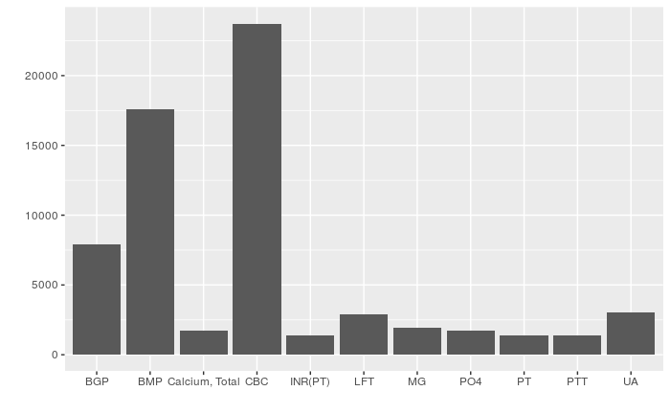
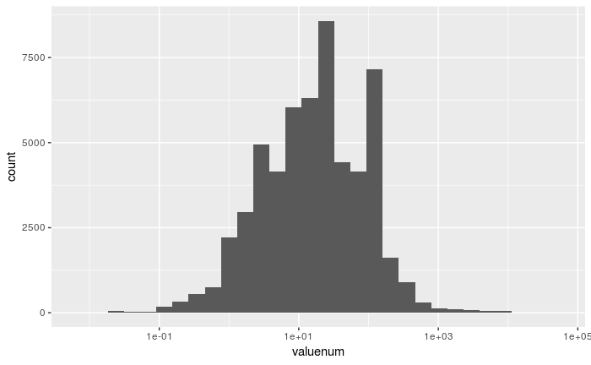
How do we explore variation in data?
Quantitative
Range, mean, median, mode
Histograms
Categorical
Frequency (counts, percent)
Bar chart

Slide 8
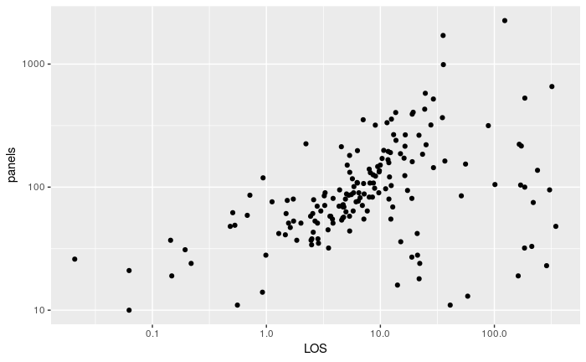
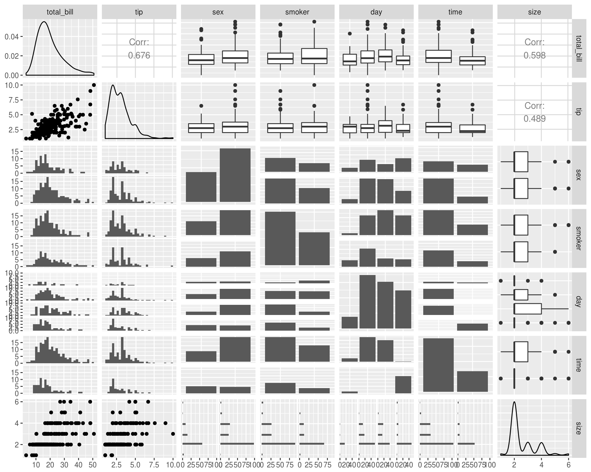
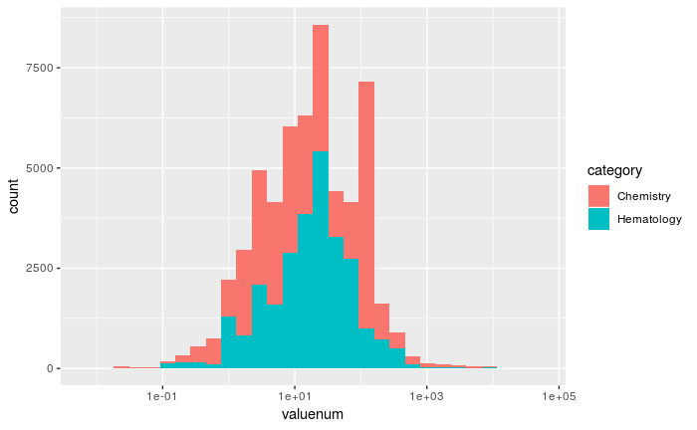
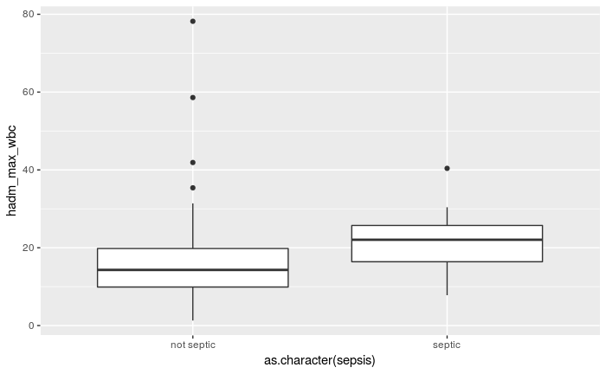
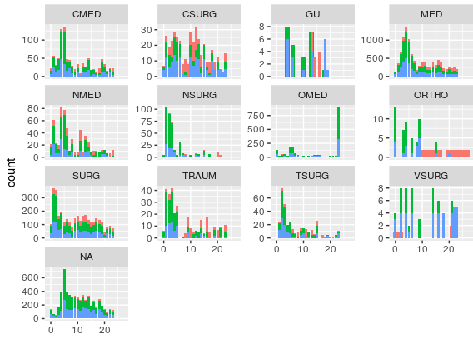

How do we explore COvariation in data?

Slide 9
EDA as Data QC
Investigate:
Missing data
Outliers
Logical discrepancies

Slide 10
Medical Information Mart for Intensive Care (MIMIC)-III data set

Slide 11
MIMIC Data set
MIMIC-III is a widely-used, freely available biomedical dataset
Developed by the MIT Lab for Computational Physiology
Deidentified health data associated with >40,000 critical care patients
Includes demographics, vital signs, laboratory tests, medications, free text notes and more
Details are available at https://mimic.physionet.org/

Slide 12
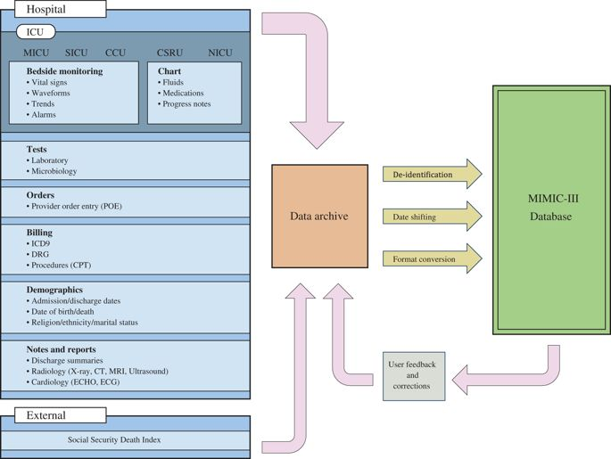

Slide 13
MIMIC Data Access
Course in protecting human research participants including HIPAA requirements.
Data use agreement
outlines appropriate data usage
security standards
forbids efforts to identify individual patients

Slide 14
Common uses for MIMIC
Educational coursework
medical analytics courses
Research
machine learning approaches for prediction of patient outcomes
semantic analysis of unstructured patient note
Datathons

Slide 15
EDA Exercise

Slide 16
EDA exercise outline
For each exercise:
Explicit task description
Use functions to complete the task
Question-set based on your findings

Slide 17

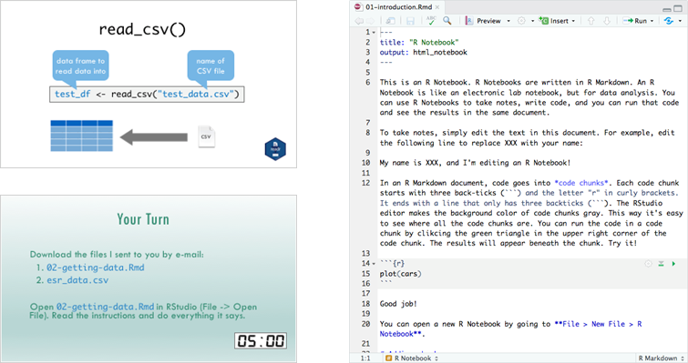
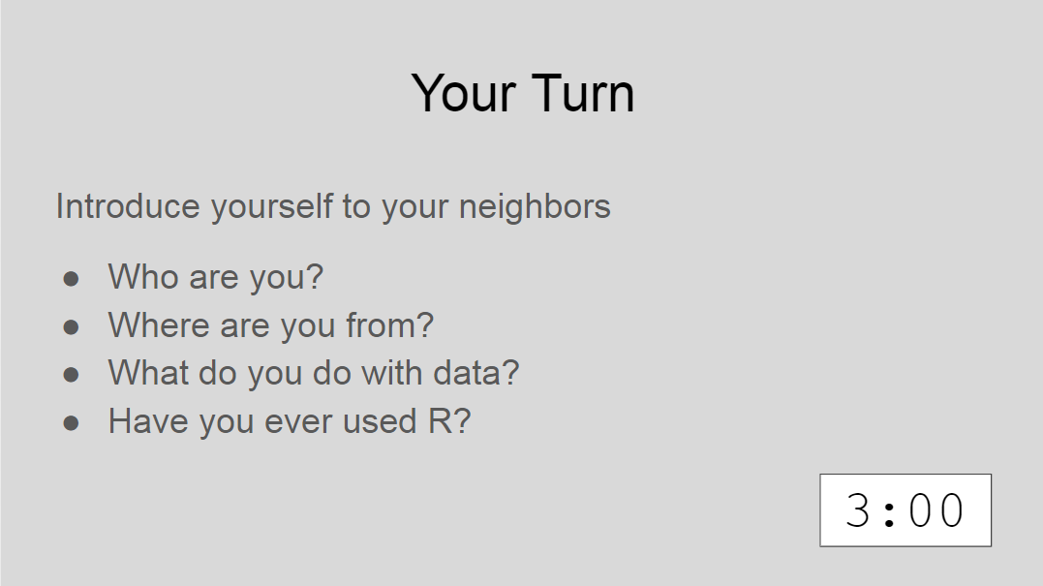

Slide 18
Exercise 0

Slide 19

Exercise 0
Use the code block below to run `library()` on "tidyverse"

Slide 20
Exercise 1
Use the read_csv() function to read mimic.csv into a new data frame called "mimic"
Explore the data frame using some of the tools we've learned today (summary(), head())

Slide 21
How many rows are in the data frame?
How many columns are in the data frame?
What does each row in the data frame represent?
How many columns contain information about the patient's admission and how many relate to the test order?

Slide 22
Exercise 2
Use `filter()` to find the rows that have NA in the valuenum column
Use `select()` to narrow down to just the "panel_test", "test_name", "component", "value" and "valuenum" columns
Use `arrange()` to order the data frame by "value" and "component" columns

Slide 23
mimic %>% filter(is.na(valuenum), !is.na(value)) %>% select(panel_test, component, value, valuenum) %>% arrange(value,component)

Slide 24
What is the difference between the "value" and "valuenum" columns?
What kind of result values in the data set appear in the "value" column but are NA in the "valuenum" column?

Slide 25
Exercise 3
Use group_by() and summarize() to get a sense for the counts of data in some of the columns with categorical data
Use n() and n_distinct inside of the summarize() function to count the rows and distinct values in each categorical variable

Slide 26
mimic %>% group_by(religion) %>% summarise(d_pt = n_distinct(subject_id))

Slide 27
How many distinct patients and admissions are in the data frame?
How many different panel tests and components are in the data frame?
What is the most common religion for patients in the data frame?
*Challenge Question* What is the most commonly ordered test in the data set?

Slide 28
Exercise 4
Use ggplot() to assess the distribution of charttime and valuenum
Try different scales to visualize the laboratory results
Use the fill aesthetic to parse out the contribution of different categorical variables, such as category or fluid types, to the distribution of laboratory values

Slide 29
ggplot(mimic)+ geom_histogram(aes(valuenum,fill=category))+ scale_x_log10()

Slide 30
What do you notice about the pattern of charttimes and valuenums in the data frame?
Are there differences between the distribution of results for "Chemistry" and "Hematology" test categorys?
Are there outlier categories with only a few results?
*Challenge Question* Can you estimate what the reference range is for the "Hemoglobin"?

Slide 31
Show and Tell 1 – What about NAs?
Missing data (NA) is important to be aware of because its presence may indicate a problem with the data or may influence the statistics and conclusions we make

Slide 32
mimic %>% mutate_all(is.na) %>% summarise_all(sum) %>% arrange(desc(value))

Slide 33
Show and Tell 2 – Characters in numeric data
Analyzing laboratory data can be challenging for several
reasons
One reason is that numeric data can often be stored as characters

Slide 34
mimic %>% filter(str_detect(value,">|<")) %>% mutate(valuenum = ifelse(str_detect(value,">|<"), parse_number(value), valuenum)) %>% select(test_name, component, value, valuenum)

Slide 35
Show and Tell 3 – Working With Dates
Medical data is inherently temporal in nature
R has several packages that help in dealing with datetime based data

Slide 36
library(lubridate) mimic %>% mutate(charthour = hour(charttime)) %>% filter(!category %in% c("HEMATOLOGY","CHEMISTRY")) %>% distinct(curr_service, category, charttime, charthour, hadm_id, panel_test) %>% ggplot(aes(x=charthour,fill=category))+ geom_bar()+ facet_wrap(~curr_service, scales = "free_y")

